Slide 1


HACKZON 2022 BRIGHT BYTE SUBHRANEEL JITHIN J NAIR VIGNESH NAIR YAGYA

Slide 2
PROJECT OBJECTIVE
The problem we have chosen is an id card problem that hangs around the neck which is annoying and hard to keep track of

Slide 3
SOLUTION
We created a solution by converting the Id- card in a form of a band. The band contains a sound scanner whenever a person tries to enter college. It is easy to handle and there is no problem with dropping it as it’s backed up to your phone.

Slide 4
LANGUAGE USED
Python

Slide 5
MODULES USED
SpeechRecognition
Pyaudio

Slide 6
SPEECH RECOGNITION
Speech recognition is the process of converting spoken words to text. Python supports many speech recognition engines and APIs, including Google Speech Engine, Google Cloud Speech API,
Microsoft Bing Voice Recognition and IBM Speech to Text.

Slide 7
PYAUDIO
Pyaudio is a Python binding for PortAudio, a cross platform library for input and output of audio. This basically means that we can use Pyaudio to record and play sound across all platforms and Operating systems such as windows, Mac and Linux.

Slide 8
FUTURE SCOPE
GPS TRACKER IT CAN BE USED.
IT IS EASY TO WEAR SUCH THAT NEEDN’T TO BE WORRIED ABOUT LOSING IT.
IT ALSO DISPLAYS TIME TOO ALONG WITH THIS .

Slide 9
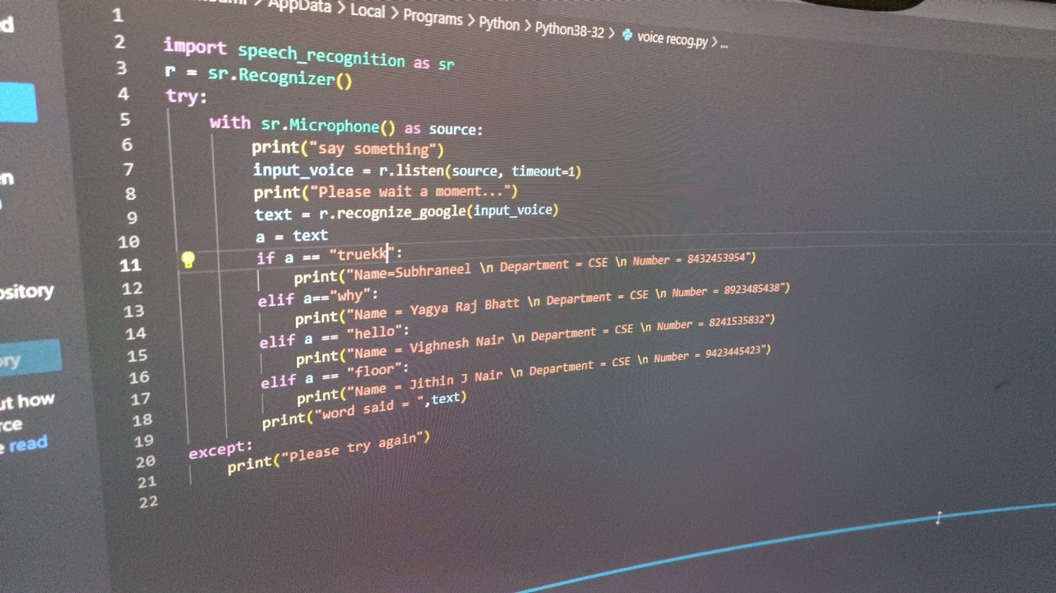
Code

Slide 10
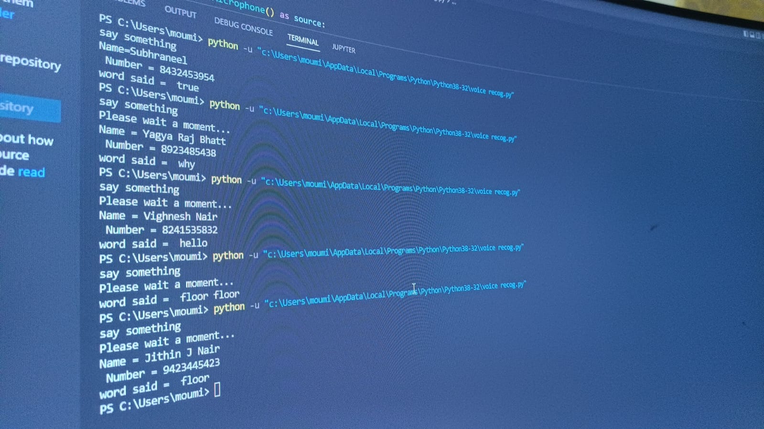
Output Screen Shot
Output screenshots

Slide 11


Band picture

Slide 12

THANK YOU!!
FROM BRIGHT BYTE

